Slide 1


Project Name STOCKITE: A Stock Trading Software
By
Indraj Singh Teotia
+91-9917536937, indrajteotia@gmail.com

Slide 2

Introduction to Stock Trading
“Stock trading broadly refers to any buying and selling of shares.

Slide 3

What is a Share?
A Share is a unit of equity ownership in the capital stock of a corporation

Slide 4
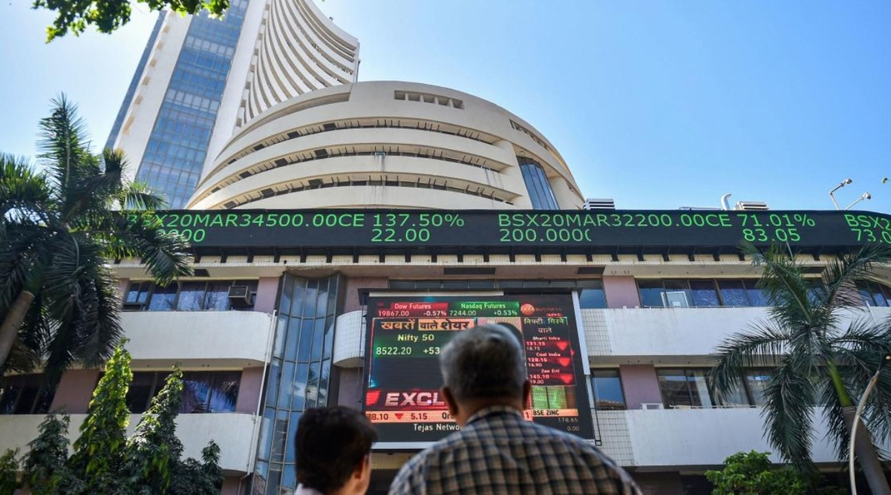
Share Market
A stock market, equity market, or share market is the aggregation of buyers and sellers of stocks, which represent ownership claims on businesses

Slide 5
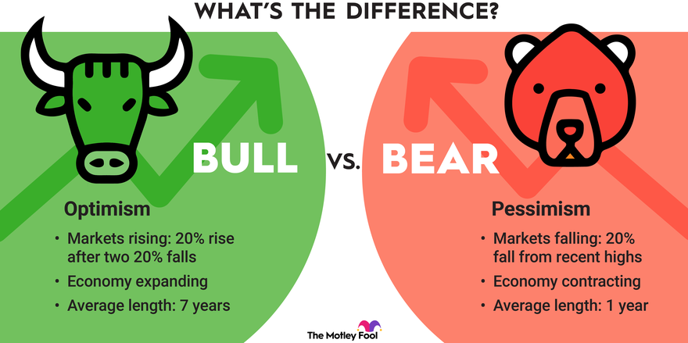
Types of Share Market

Slide 6



Major Stock Exchanges in INDIA
NSE (National Stock Exchange)
BSE (Bombay Stock Exchange)
MCX (Multi Commodity Exchange)

Slide 7
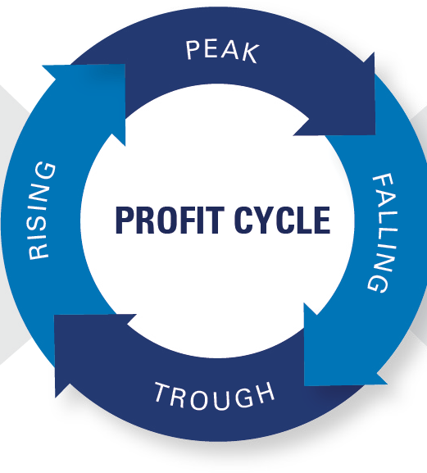
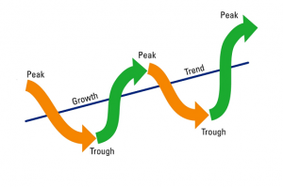
What gives profit?
Buying at low (dip)
Sell at high (peak)

Slide 8

Why one should invest?
Maximise returns
Beat Inflation

Slide 9

Why one should invest?
Reach financial goals
Keep pace in life

Slide 10
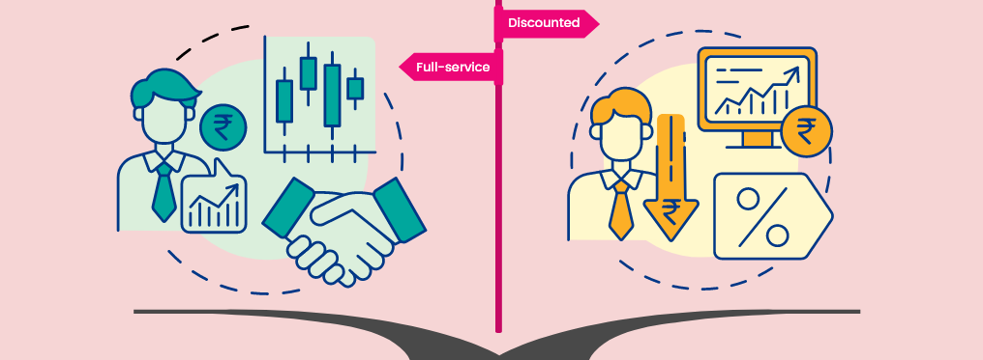
Who is a Broker?
A broker is a party that mediates between a buyer and a seller.

Slide 11
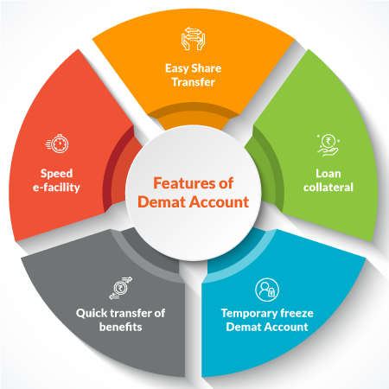
What is a Demat Account?
The term DEMAT refers to a dematerialized account.
Demat Account helds shares and securities in electronic form.

Slide 12
THANKYOU

